Slide 1
MODUL AJAR
MATA KULIAH PILIHAN
METAHEURISTIK
ALGORITMA GENETIKA
Oleh:
Hayati Mukti Asih^{1*}, Raden Achmad Chairdino Leuveano², Dhimas Arief Dharmawan³
¹ Department of Industrial Engineering, Faculty of Industrial Technology, Universitas Ahmad Dahlan
² Department of Industrial Engineering, Faculty of Industrial Engineering, Universitas Pembangunan Nasional "Veteran" Yogyakarta
³ Department of Informatics, Faculty of Industrial Engineering, Universitas Pembangunan Nasional "Veteran" Yogyakarta

Slide 2
CAPAIAN PEMBELAJARAN LULUSAN &
CAPAIAN PEMBELAJARAN MATA KULIAH
CPL 5
CPMK 5.59
Mampu menerapkan konsep sains, matematika, dan prinsip-prinsip rekayasa untuk mengidentifikasi, memformulasikan dan menganalisis masalah rekayasa kompleks pada sistem terintegrasi (meliputi manusia, material, peralatan, energi, dan informasi) berdasarkan pendekatan analitik, komputasional atau eksperimental
Mampu menemukan solusi penyelesaian kasus yang menerapkan Genetic Algorithm dengan baik

Slide 3
INTRODUCTION
A genetic algorithm is a search heuristic that is inspired by Charles Darwin’s theory of natural evolution.
This algorithm reflects the process of natural selection where the fittest individuals are selected for reproduction in order to produce offspring of the next generation.

Slide 4
NATION OF NATURAL SELECTION
The process of natural selection starts with the selection of fittest individuals from a population. They produce offspring which inherit the characteristics of the parents and will be added to the next generation. If parents have better fitness, their offspring will be better than parents and have a better chance at surviving. This process keeps on iterating and at the end, a generation with the fittest individuals will be found.
This notion can be applied for a search problem. We consider a set of solutions for a problem and select the set of best ones out of them.

Slide 5
FIVE PHASES OF GENETIC ALGORITHM
1
2
3
4
5
6

Slide 6
INITIAL POPULATION
The process begins with a set of individuals which is called a Population. Each individual is a solution to the problem you want to solve.
An individual is characterized by a set of parameters (variables) known as Genes. Genes are joined into a string to form a Chromosome (solution).
In a genetic algorithm, the set of genes of an individual is represented using a string, in terms of an alphabet. Usually, binary values are used (string of 1s and 0s). We say that we encode the genes in a chromosome.

Slide 7
INITIAL POPULATION
FITNESS FUNCTION
The fitness function determines how fit an individual is (the ability of an individual to compete with other individuals). It gives a fitness score to each individual. The probability that an individual will be selected for reproduction is based on its fitness score.

Slide 8
SELECTION
The idea of selection phase is to select the fittest individuals and let them pass their genes to the next generation.
Two pairs of individuals (parents) are selected based on their fitness scores. Individuals with high fitness have more chance to be selected for reproduction.

Slide 9
CROSSOVER
Crossover is the most significant phase in a genetic algorithm. For each pair of parents to be mated, a crossover point is chosen at random from within the genes.
Offspring are created by exchanging the genes of parents among themselves until the crossover point is reached.
The new offspring are added to the population.

Slide 10
MUTATION
In certain new offspring formed, some of their genes can be subjected to a mutation with a low random probability. This implies that some of the bits in the bit string can be flipped.
Mutation occurs to maintain diversity within the population and prevent premature convergence.

Slide 11
TERMINATION
The algorithm terminates if the population has converged (does not produce offspring which are significantly different from the previous generation). Then it is said that the genetic algorithm has provided a set of solutions to our problem.
The population has a fixed size. As new generations are formed, individuals with least fitness die, providing space for new offspring.
The sequence of phases is repeated to produce individuals in each new generation which are better than the previous generation.

Slide 12
STOPPING CONDITIONS FOR THE ALGORITHM (1)
Generations — The algorithm stops when the number of generations reaches the value of Generations.
Time limit — The algorithm stops after running for an amount of time in seconds equal to Time limit.
Fitness limit — The algorithm stops when the value of the fitness function for the best point in the current population is less than or equal to Fitness limit.
Stall generations — The algorithm stops when the average relative change in the fitness function value over Stall generations is less than Function tolerance.

Slide 13
STOPPING CONDITIONS FOR THE ALGORITHM (2)
Stall time limit — The algorithm stops if there is no improvement in the objective function during an interval of time in seconds equal to Stall time limit.
Stall test — The stall condition is either average change or geometric weighted. For geometric weighted, the weighting function is 1/2n, where n is the number of generations prior to the current. Both stall conditions apply to the relative change in the fitness function over Stall generations.
Function tolerance — The algorithm runs until the average relative change in the fitness function value over Stall generations is less than Function tolerance.
Constraint tolerance — The Constraint tolerance is not used as stopping criterion. It is used to determine the feasibility with respect to nonlinear constraints. Also, max(sqrt(eps),ConstraintTolerance) determines feasibility with respect to linear constraints.

Slide 14
Case Study
PENELITIAN KERJASAMA DALAM NEGERI
(UAD x UPN “Veteran” Yogyakarta) – DRTPM 2023
Optimizing Lot Sizing Model for Perishable Bread Products using Genetic Algorithm
Hayati Mukti Asih^{1*}, Raden Achmad Chairdino Leuveano², Dhimas Arief Dharmawan³
¹ Department of Industrial Engineering, Faculty of Industrial Technology, Universitas Ahmad Dahlan
² Department of Industrial Engineering, Faculty of Industrial Engineering, Universitas Pembangunan Nasional "Veteran" Yogyakarta
³ Department of Informatics, Faculty of Industrial Engineering, Universitas Pembangunan Nasional "Veteran" Yogyakarta

Slide 15
LOT SIZING FOR PERISHABLE PRODUCT

Slide 16
RESEARCH DESIGN
Characteristic of the system:
Dynamic demand
Return rate
Deterioration rate
Mathematical model
-to formulate the problem of lot sizing for perishable products
GENETIC ALGORITHM
Output
- optimum order quantity to minimize total expected cost

Slide 17
THE DEVELOPMENT OF MATHEMATICAL MODEL

Slide 18
THE DEVELOPMENT OF MATHEMATICAL MODEL

Slide 19
Total costs generated by a test run of the GA

Slide 20
GA search process in the 6th experiment of the 3rd replication

Slide 21
ASSESSMENT
Mention two other case studies that could be optimized using Genetic Algorithm!
Explain its chromosome and fitness function for each case study!
Assessment time is 30 minutes, submitted before class.

Slide 22
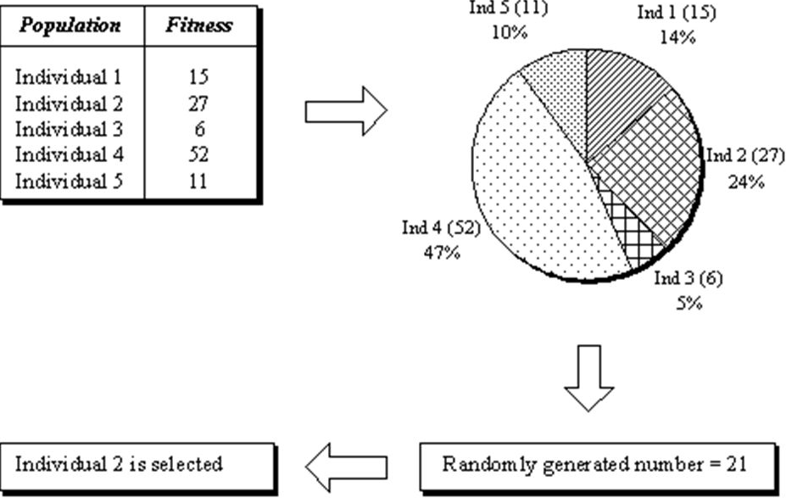
PRESENTATION TASK FOR THE NEXT MEETING:
Describe these methods and give examples!
Selection
Rank – based fitness assignment
Roulette wheel selection
Stochastic universal sampling
Local selection
Truncation selection
Tournament selection
Crossover
Single – point crossover
Multi-point crossover

