Slide 1
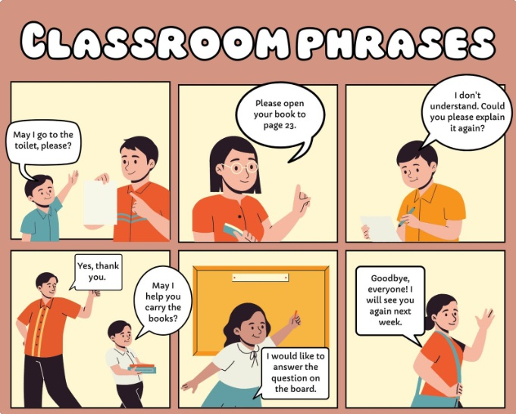



Creating Your Own Comic Strips
Learn the fundamentals of comic storytelling and bring your characters to life!
Indah Fajar Wahyuni, M.Hum

Slide 2

Brainstorming Ideas
Character Design
Setting
What kind of characters are you going to create? Heroes, villains, everyday people?
Where does the story take place?
Plot
Theme
What conflict will drive your story?
What message or emotion are you trying to convey?

Slide 3
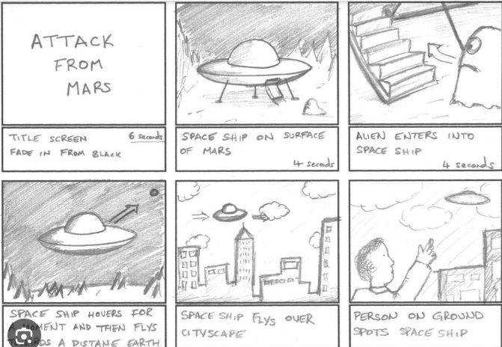
Storyboarding
1
Outline the sequence of events.
2
Each panel tells a small part of the story.
3
Use arrows to show the order of panels.

Slide 4
Panel Layout
Grid Format
Placement Matters
Panels are arranged in a grid, like squares in a checkerboard.
Size and position can influence the reader's attention.

Slide 5
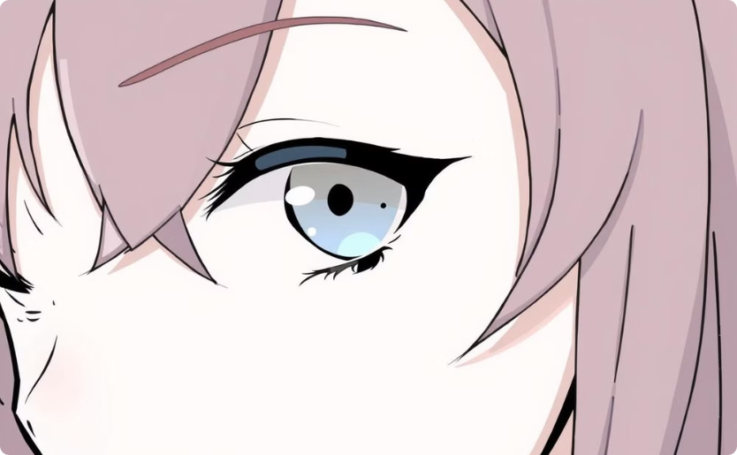

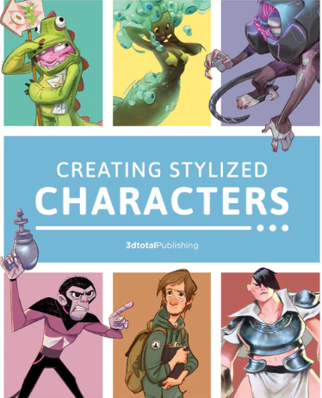
Character Design
Facial Expressions
Body Language
Convey emotions through eyes, eyebrows, and mouths.
Illustrate personality through posture and gesture.

Slide 6
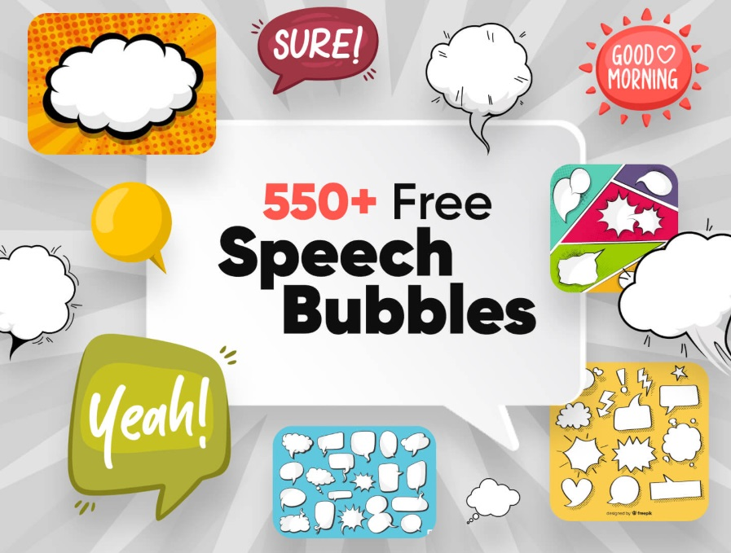



Dialogue and Speech Bubbles
Types of Bubbles
Speech bubbles, thought bubbles, narration boxes.
Font and Size
Choose fonts that match the tone of the dialogue.
Placement
Ensure readability and clarity.

Slide 7



Adding Details
Setting
1
Create a believable environment.
Background
2
Add depth and context.
Effects
3
Use sound effects, motion lines, and shading to add impact.

Slide 8
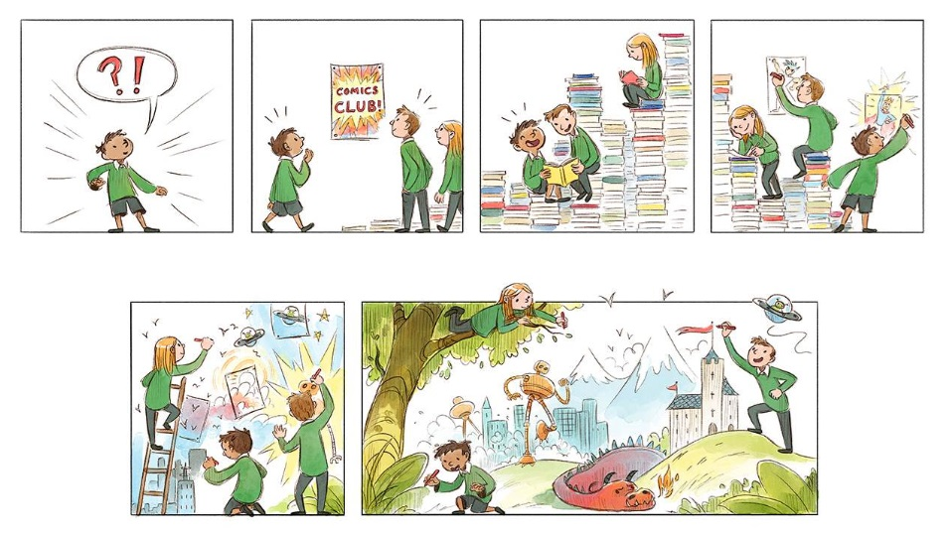
Finishing Touches
Coloring, lettering, and final touches add polish and visual impact.

Slide 9

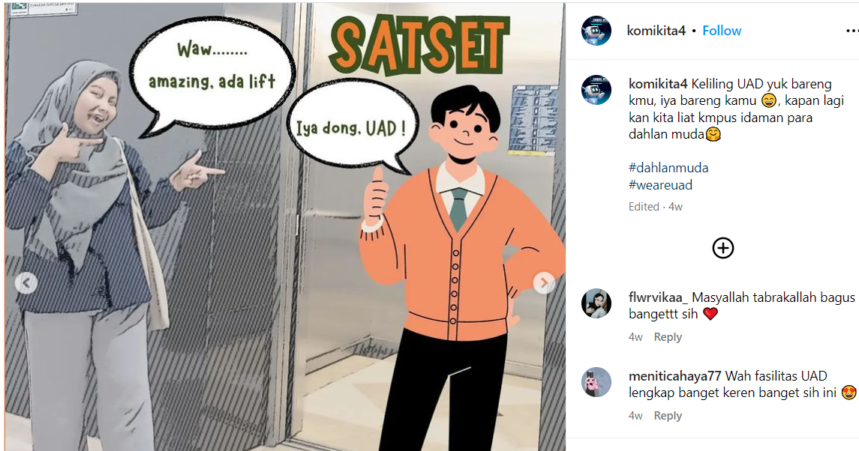
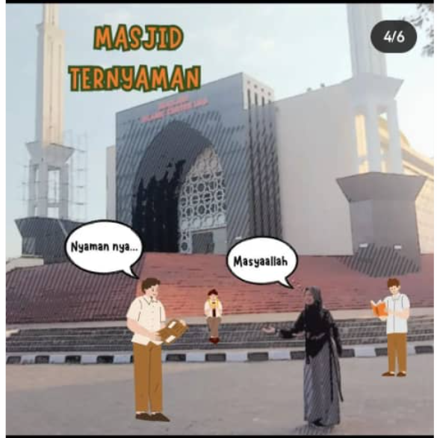

Slide 10


