Slide 1

PHYTOSOME FORMULATION OF RED DRAGON FRUIT EXTRACT
Novi Febrianti¹, Lina Widiyastuti², Agung Dwi Nugroho², Aulia Nugrahaningtyas¹, Natasya Dwi Karina¹
¹ Biology Education Study Program, Faculty of Teacher Training & Education,
² Pharmacy Study Program, Faculty of Pharmacy
Universitas Ahmad Dahlan
Yogyakarta, July 17 2024

Slide 2
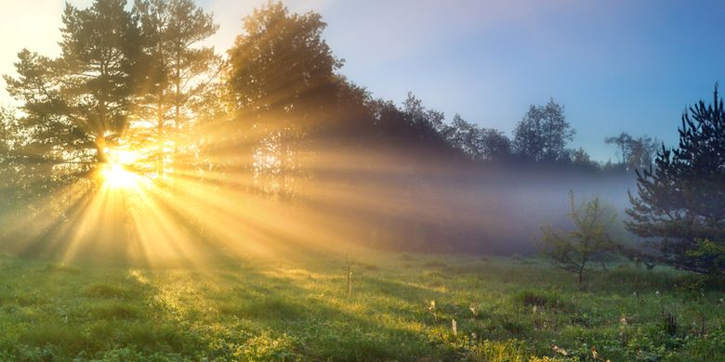
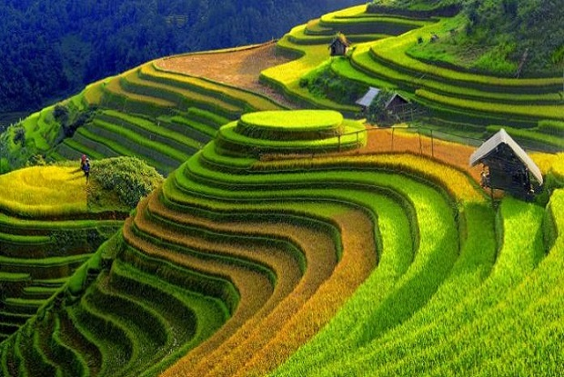
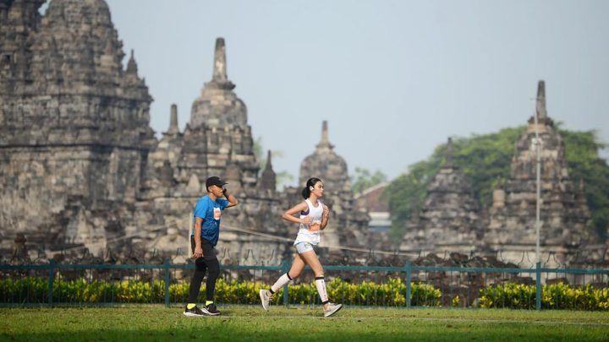
INDONESIA
Notes:
Indonesia is a tropical country whose position is on the equator so it receives exposure to sunlight throughout the year. This causes almost all regions in Indonesia to receive sunlight with high ultra violet (UV) index values, ranging from 10-11 (very strong and extreme category).

Slide 3
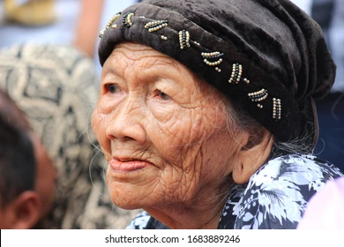
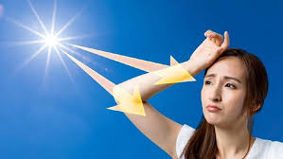
AGING
The effects of UV that damage the skin come from exposure to UVA and UVB radiation.
UVB can penetrate the epidermis and dermis layers so that it can induce oxidative stress, inflammatory responses, DNA damage, and suppression of immune reactions in the skin (Cavinato & Jansen-Dürr, 2017)
DNA damage to skin cells due to high UV exposure and also the presence of reactive oxygen species (ROS) that arise due to UV is an event early molecular changes, which will lead to premature skin aging (Ganceviciene et al. (2012)
Notes:
This condition causes the risk for people in the area of ​​developing various skin disorders and premature skin aging to be very high.
Skin is an important part of the body that is directly exposed to UV rays. The effects of UV that damage the skin come from exposure to UVA and UVB radiation, because UVC radiation cannot reach the earth's surface. UVB radiation has a more dangerous effect because it has greater damaging power than UVA. According to Cavinato & Jansen-Dürr (2017), UVB has the ability to penetrate the epidermis and dermis layers so that it can induce oxidative stress, inflammatory responses, DNA damage, and suppression of immune reactions in the skin. Ganceviciene et al. (2012) stated that DNA damage to skin cells due to high UV exposure and also the presence of reactive oxygen species (SOR) that arise due to UV is an event
early molecular changes before skin histology changes and skin damage occur which will lead to premature skin aging.

Slide 4
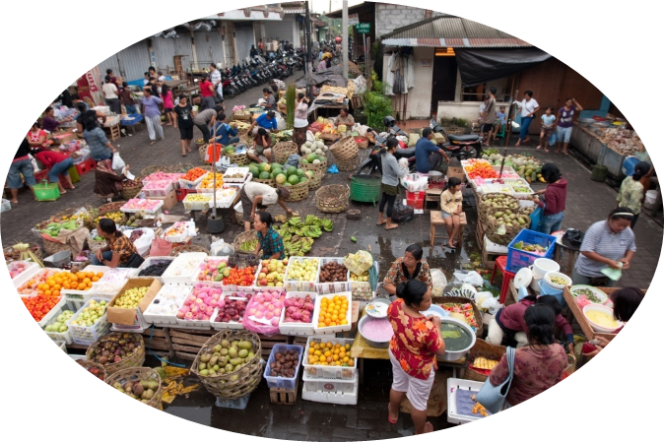

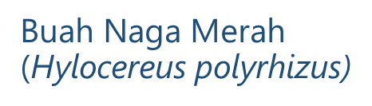
FRUIT DIVERSITY IN INDONESIA
Flesh of fruit contain polyphenol, flavonoid, betacyanin, beta-caroten, licopen, vitamin E (Charoensiri et al., 2009; Dembitsky et al.,2011)
Seed contain 50% essensial fatty cid, namely linoleate acid (C18:2) 48% dan linolenat acid (C18:3) 1,5% (Charoensiri et al., 2009; Dembitsky et al.,2011)
Notes:
Indonesia is a tropical country that has very high natural wealth, including a wealth of fruit types that have the potential to act as anti-aging agents. To achieve the national independence that Indonesia wants to achieve by 2030, it is very necessary to explore Indonesia's rich types of tropical fruit which are rich in antioxidants for use as antiaging agents.
Red dragon fruit (Hylocereus polyrhizus) is a type of tropical fruit that contains various types of antioxidants

Slide 5
BACKGROUND
Febrianti (2019) explain that red dragon fruit flesh extract has a protective effect on fibroblast cell cultures exposed to UVB and can also increase collagen synthesis so that it can be used as a base for antiaging creams
Several studies have utilized red dragon fruit for treatment, skin protection against UVB, and as an anti-aging ingredient
In vivo, the application of red dragon fruit flesh extract is water soluble, so its bioavailability is low
An appropriate delivery medium needs to be applied to a face cream. One of the widely used media is phytosomes

Slide 6
OBJECTIVE
Formulate a phytosome of red dragon fruit flesh extract
Determine the physical characteristics of phytosom of red dragon fruit flesh extract

Slide 7
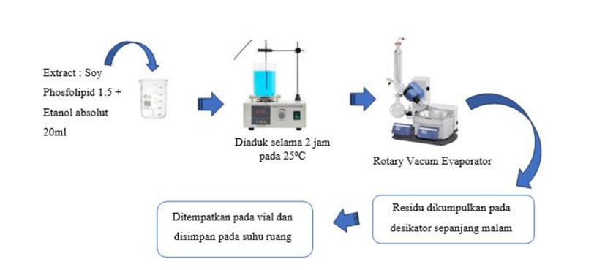
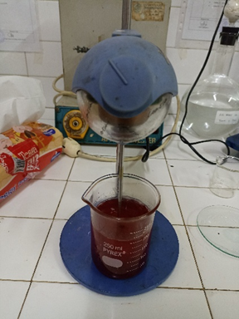
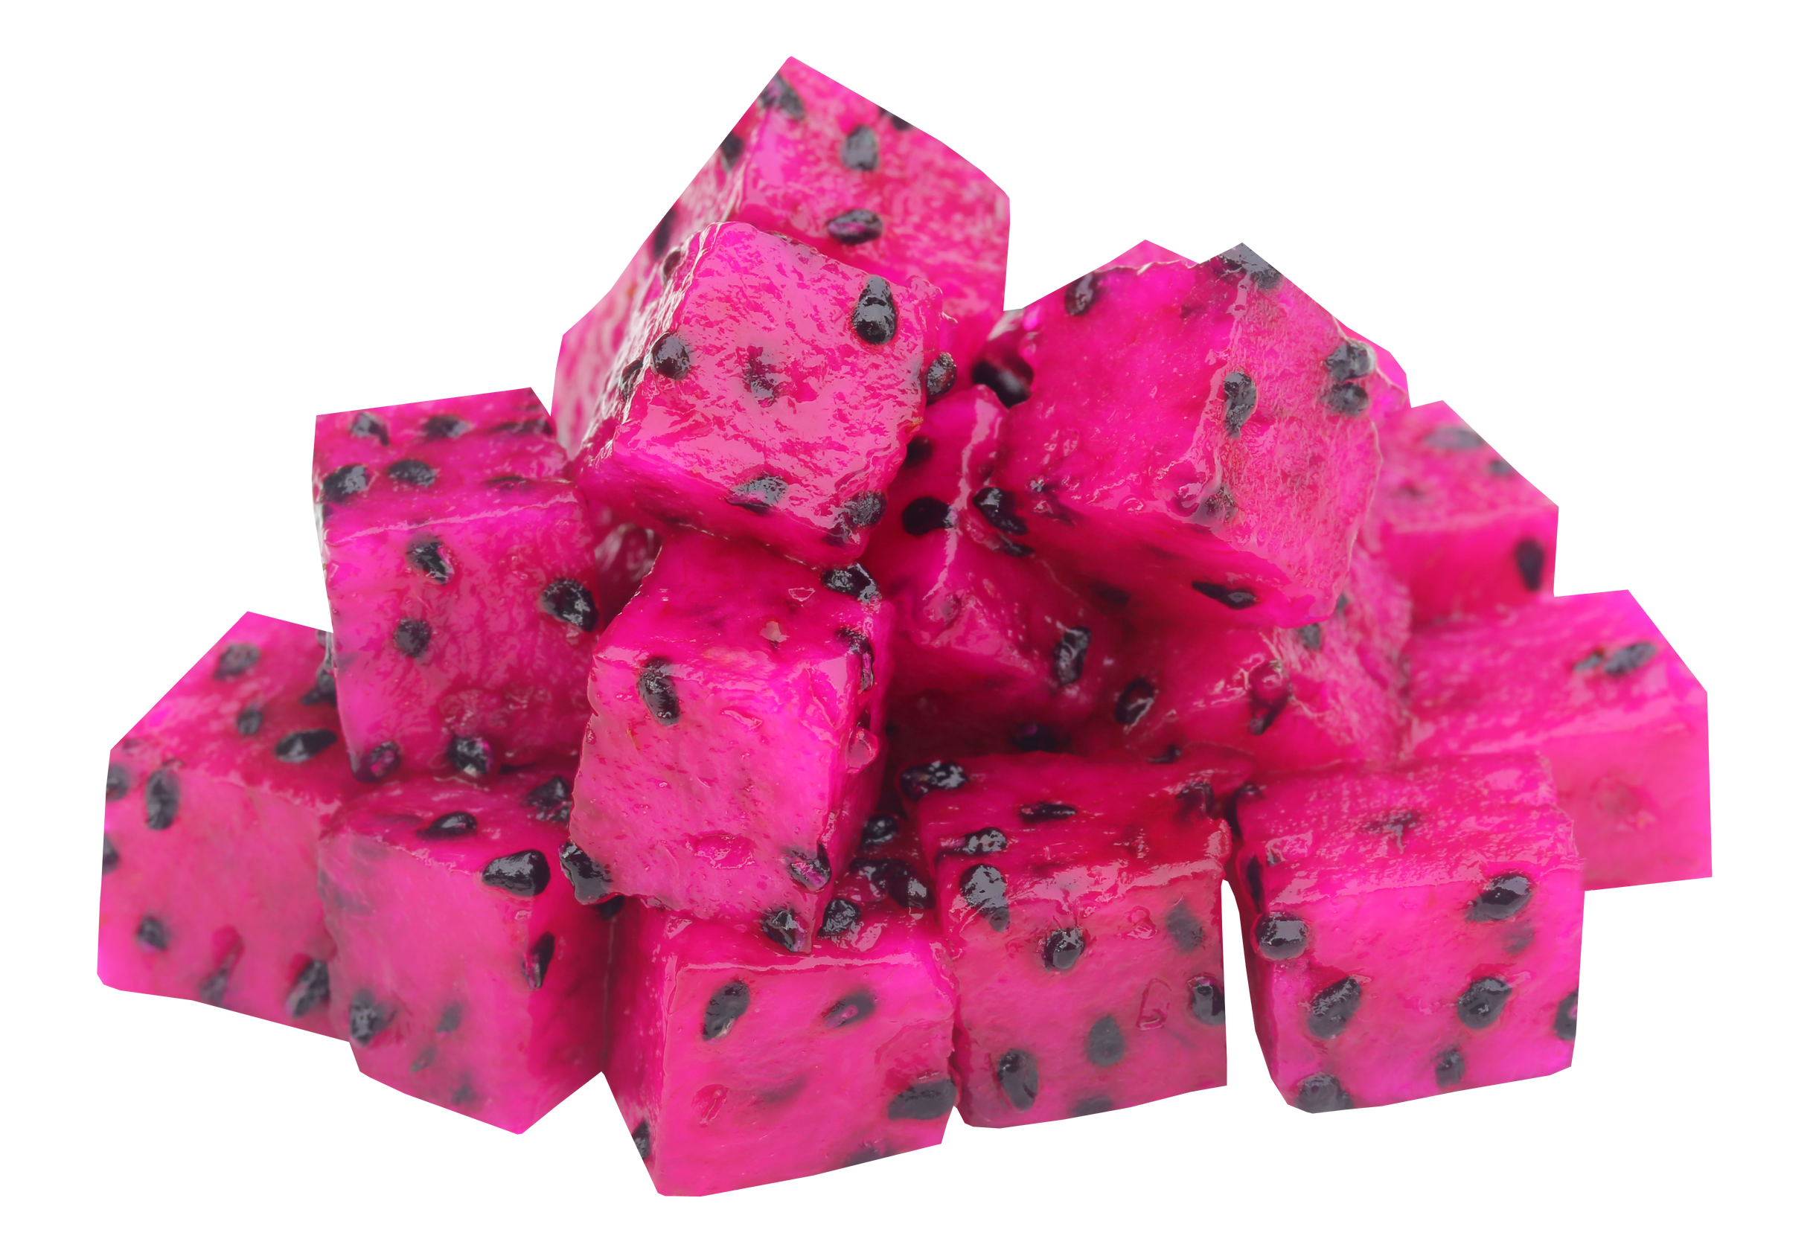
METHODE
Collection of Red Dragon Fruit Sample
Preparation of Red Dragon Fruit Extract
Evaluation of the Physical Characteristics of Phytosom
Evaluation of Phytochemicals (Phenol, Flavonoid)
Entrapment Efficiency Assay
Phytosome Formulation (Thin layer hidration methode)
Notes:
Samples of red dragon fruit were collected from a dragon fruit plantation in Hargobinangun, Pakem, Sleman DIY which is 38 km from UAD campus 4. The collected red dragon fruits are ripe, not deformed, and ready to be harvested
Red dragon fruit samples were washed in running water and then dried using a clean and dry cloth. The dried fruit was cut into four parts, then peeled and pulped by hand. The pulp was blended to obtain a paste-like preparation for 3-5 minutes. The red dragon fruit pulp paste was then freeze-dried using a freeze dryer to reduce its moisture
2.4 Phytosome formulation of red dragon fruit extract
Phytosome preparation was carried out using the thin-layer hydration method. Phytosome complex formation was done by combining red dragon fruit extract and phosphatidylcholine in ethanol. The combination of red dragon fruit extract and phosphatidylcholine are 1:1, 1:2, and 1:5

Slide 8
RESULT
The yield value of red dragon fruit flesh extract : 6.07%.
Moisture of red dragon fruit extract : 30.31%.
The total phenolic content of extract :10.77 mg GAE/g extract.
The total flavonoid content of extract :19.61 mg QE/g extract.

Slide 9
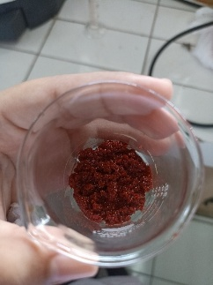
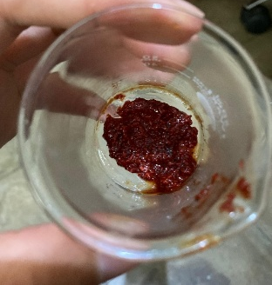
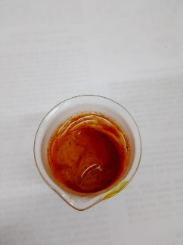
RESULT
Phytosomes with various combinations of red dragon extract and lecithin
1:1 1:3 1:5
Phytosome with 1:5 combination had an entrapment efficiency 62.97% ± 0.025.

Slide 10
CONCLUSION
The phenolic and flavonoid content of red dragon fruit extract is 10,767 mgGAE/g and 19,606 mgGAE/g, respectively.
Phytosomes with the ratio of dragon fruit extract and lecithin 1:5 produced the optimum formula with 62,97% of entrapment efficiency

Slide 11
Notes
This research is still ongoing. Currently, we are conducting an antioxidant activity assay and observations using SEM.
We hope the results will confirm the phytosome formation that is small enough so they can be applied to the skin effectively

Slide 12
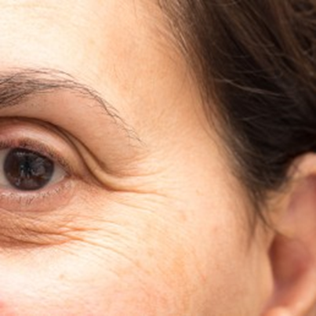
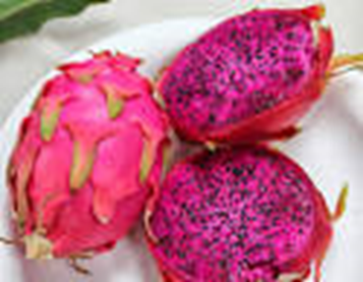
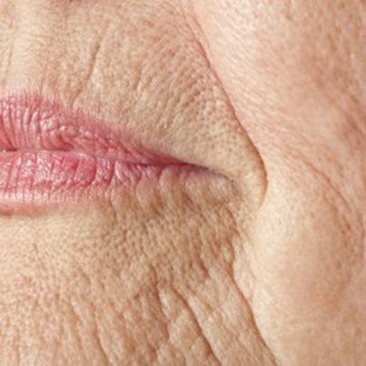
Matur nuwun…

Slide 13


